Slide 1


PRESENTATION
Morse Code Generator and Decoder
200021337 200021341
200021347 200021361

Slide 2
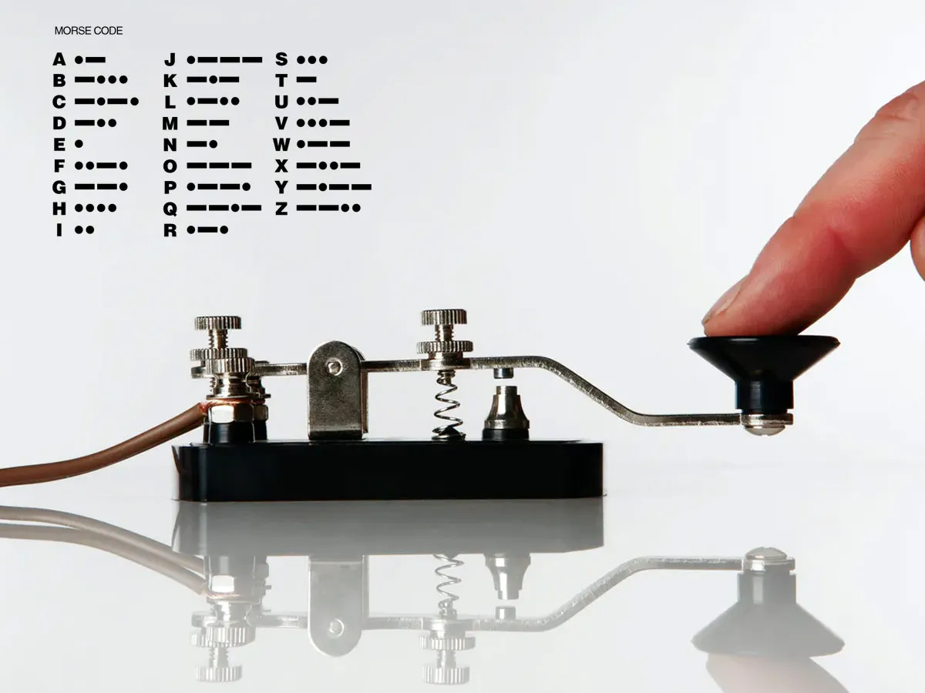

INTRODUCTION
A user-friendly, real-time Morse code decoder that allows users to input Morse signals and receive instant text output

Slide 3
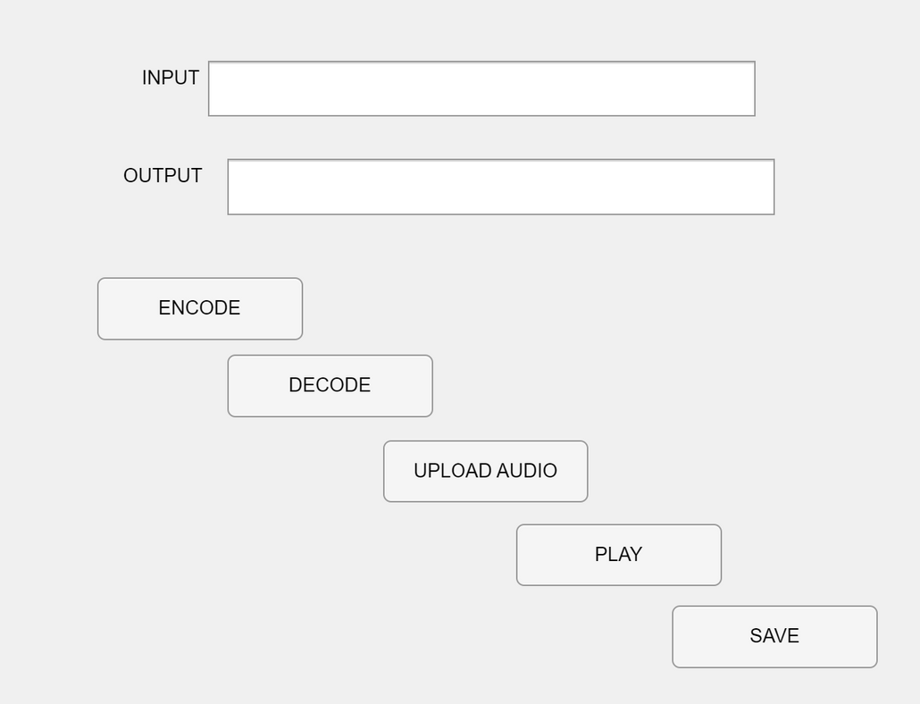


MATLAB APP DESIGNER
User Input Section
Output Display
Processing & Decoding Section

Slide 4


Morse Code
Encoding
Convert Text
to
Corresponding
Morse
Concatenate
the
Morse Code in
a variable
User
Input
Output the Morse Code In
Text Box
C
-.-.

Slide 5
Audio Generation
0.1s Duration Signal
Dot
Save the
Generated
Audio
Morse
Code
0.3s Duration Signal
Dash

Slide 6
DECODING INTO AUDIO
Edge
detection
Upload
audio file
Process and
filter data
Threshold
detection
Display
decoded
text
Decode
using
LUT
Dot and dash
classification
Token
detection

Slide 7

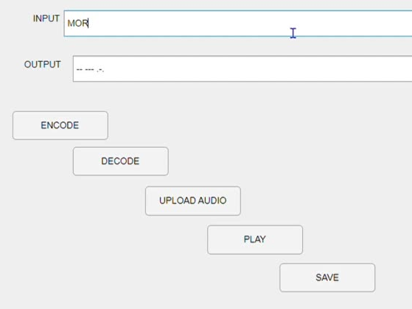


GUI INTERACTIVITY
ENCODING
Saved File

Slide 8
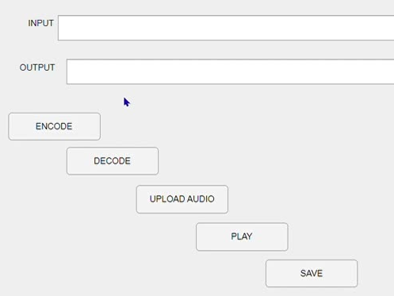
GUI INTERACTIVITY
DECODING

Slide 9


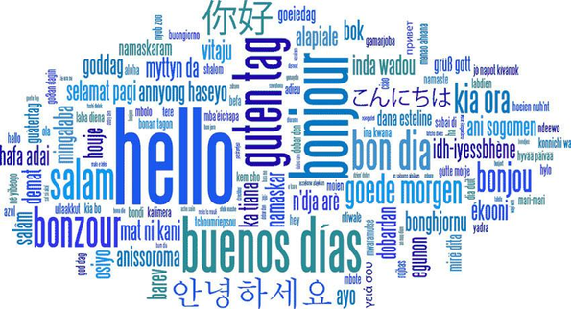
ROOM FOR IMPROVEMENT
SUPPORT FOR LONGER
MESSAGES
REAL-TIME MORSE CODE
DETECTION
MULTI-LANGUAGE SUPPORT

Slide 10


SALFORD & CO.
THANK YOU!!!
HOME
ABOUT
CONTACT
We are open for any question...........

